Slide 1
Mathematical Tools in DIP
Array and Matrix operations
Linear & Non-linear Operations
Arithmetic operations
Set operations
Logical operations
Spatial Operations
Image Transforms

Slide 2
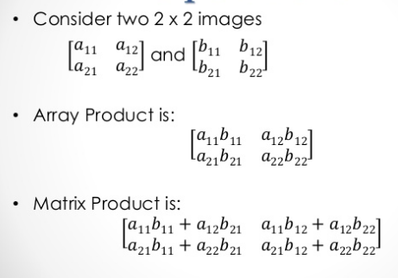
Array and Matrix operations

Slide 3
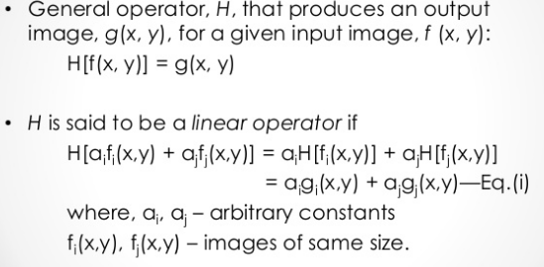
Linear Vs. Non-linear Operations

Slide 4
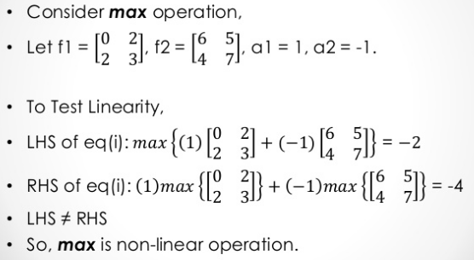
Example

Slide 5
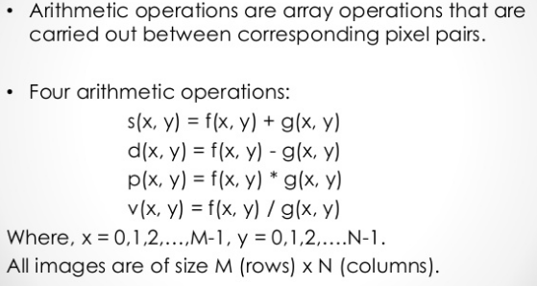
Arithmetic Operations

Slide 6
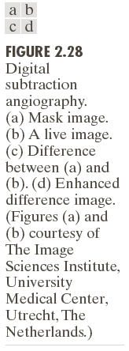
Arithmetic operator
(Image subtraction)

Slide 7
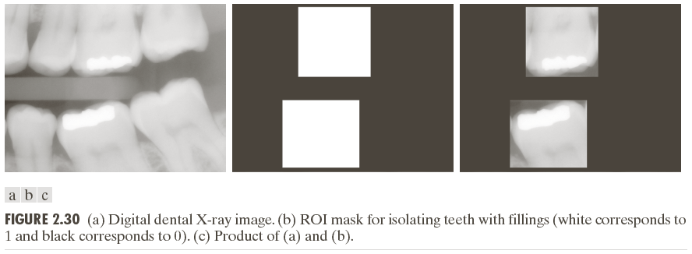
Image Multiplication

Slide 8
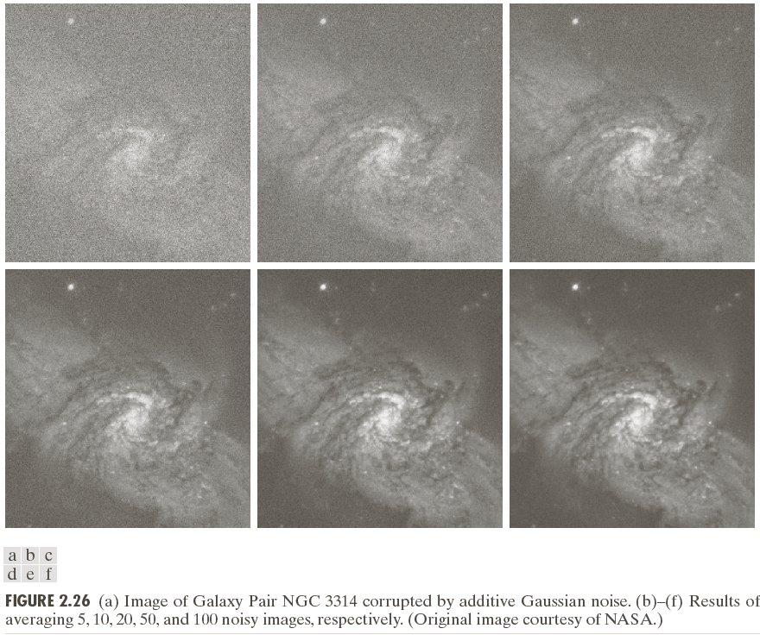
Image Averaging

Slide 9
Set operations

Slide 10
Example

Slide 11
Logical Operations

Slide 12
Spatial Operation
Single-pixel operation
Neighborhood operation
Geometric transformation

Slide 13
Single pixel operation
Image negative

Slide 14
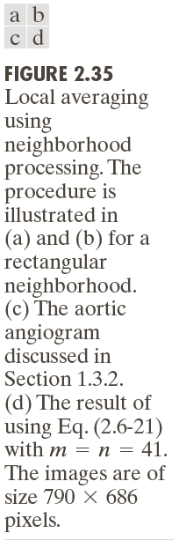
Spatial Operation(neighborhood)

Slide 15
Geometric operation
Spatial Transformation
Intensity Interpolation

Slide 16
Geometric Transformation

Slide 17
Image Transform

